Slide 1
React - Getting Started

Slide 2




React
•
React is a framework for building modern single-page applications
Official docs Tutorials
www.react.org

Slide 3
React Features
•
Component-based framework
•
Declarative views
•
Component logic is written with JavaScript
•
Supports responsive web design and modern frameworks
•
Bootstrap, Google Material Design and others …

Slide 4


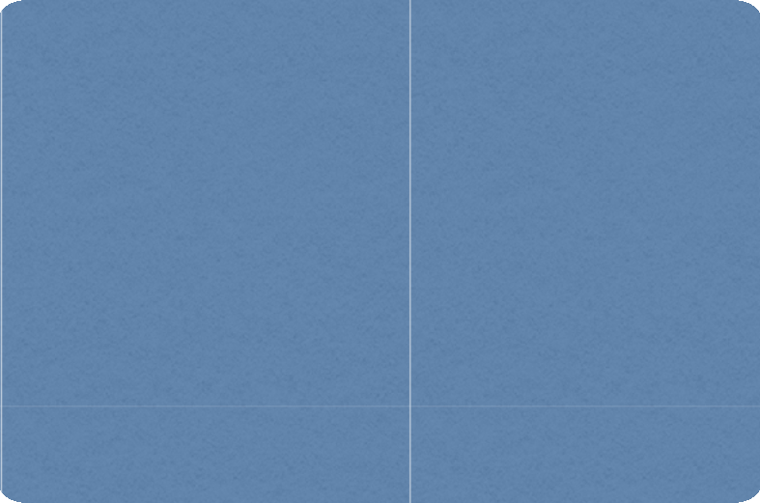


React Architecture
Renders HTML
Components
JavaScript
Single Module
Child Components
Child Components
Child Components
State
my-component.js

Slide 5







Key Terms
Term | Definition
Component | Main player in an React application. Has two parts: View for user interface JavaScript that contains application logic / event handling for the view
Props | How we will pass data from a parent component to a child component
State | Contains data about the component. When the state changes, the component will re-render.
Hooks | A way to use local state and other React features without writing a new class
Module | A collection of related components, that create a specific view.

Slide 6

Application UI Composition
Header Component
Main Content Component Todo List Component
Page Navigation Component
Footer Component

Slide 7
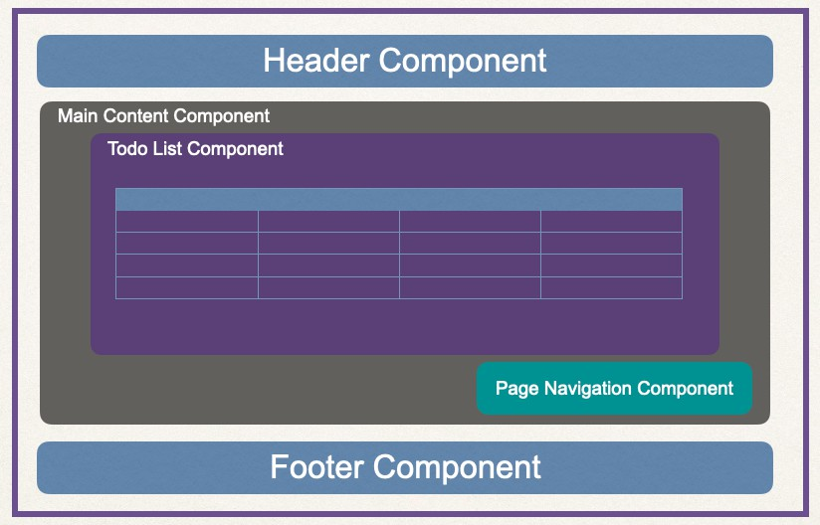


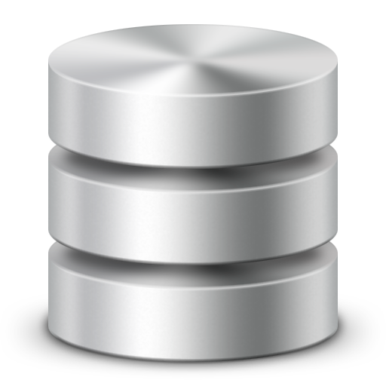



Application Interaction
React Project
REST API
component.js
Spring Boot
back-end

Slide 8

React Project
An React project is composed of multiple files
HTML
HTML
Images
Images
CSS
CSS
HTML
HTML
Others
…
CSS
CSS
JavaScript
JavaScript
Config
Config
JavaScript
JavaScript
Config
Config

Slide 9


Creating an React Project
•
React provides a command-line tool to generate a project
•
Generates the starter files to help you bootstrap your project
Creating a React App is easy

Slide 10
Creating a new React application
npx create-react-app my-app

Slide 11
Running your new React application
cd my-app
npm start

Slide 12



Creating a new React application
npx create-react-app my-app
Creates a brand new React application without you having to do any build configurations!
Running your new ReacSwteaetp!! plication
cd my-app
Jump into your new React application directory
Builds the app (compile / transpile)
Starts the server
Watches the source files
Rebuilds the apps when source is updated (hot reload)
npm start

Slide 13

Changing the Server Port
set PORT=5100 && npm start
Server listens on port 5100 http://localhost:5100

Slide 14


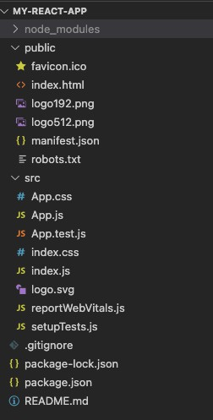


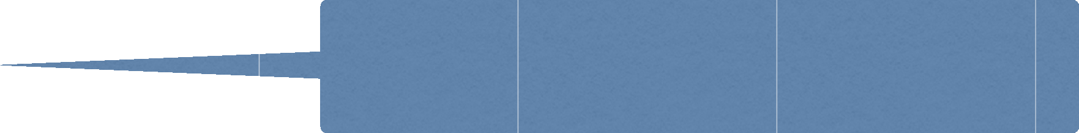




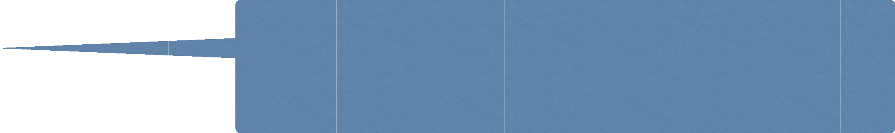

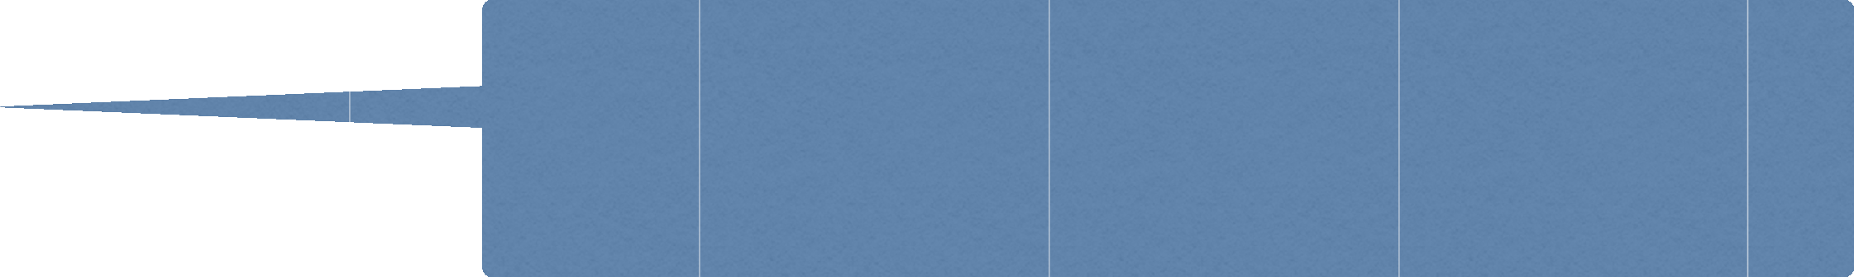












Project Files
Holds all installed libraries from node pack manager (npm)
The HTML and^{w}D^{it}O^{hi}M^{n t}f^{h}o^{e}r t^{f}hªe^{vi}R^{co}e^{n}act
React Logo
application
React logo
at a specific size
size
React logo
Used to
at a specific
Provides information about the project. Name,
author, icon etc. all inside a JSON file
prevent search engine and bots
on the React application
to crawl
Global CSS
your React ap_{f}p_{o}l_{r}ic_{y}a_{o}ti_{u}o_{r}n directory for your React fo^{ap}r ^{p}in^{li}d^{c}eªx^{ti}.ºh^{n}tml file
Global
JavaS^{f}cºr^{r}ipt component React application
Global tests
The main root index.html file
component. Hooks onto the
to be able to start rendering components
CSS
We can skip
to use Git
Files for
Git to ignore if you plan
& remote repositories
Lock dependencies to a specific version
number and records versioning for installation
Used for dependencies, defining project
properties, description, author, licensing and more
Your personal README for your React project :-)

